Slide 1
Brain Growth & Curiosity

Slide 2
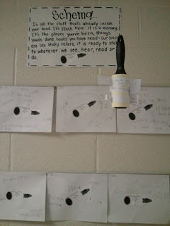
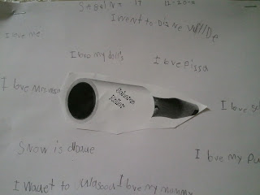
Notes:
Start off by placing small pieces of paper all over. On each slip of paper write a memory, place you’ve been, something you’ve experienced or something from a book you’ve read: "Minnesota is really cold in the winter", "Running a race is hard work, but you feel really proud when you pass the finish line" "Fishing" etc. Take the lint {schema} roller and pick up one piece at a time, read it out loud, share the thought or idea. After picking up each piece of paper with schema roller, talk about how our brains are like that sticky roller. The things we see, hear, do, read all get stuck in our brains - just like the pieces of paper stuck to this sticky roller. This builds our schema--or--prior knowledge. This allows us to make connections to new information!

Slide 4
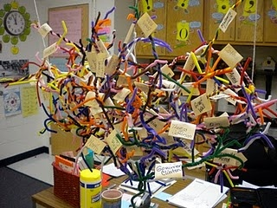
Let’s make a brain!
Notes:
Lesson plan for “making a class brain” is hyperlinked to the picture.

Slide 5
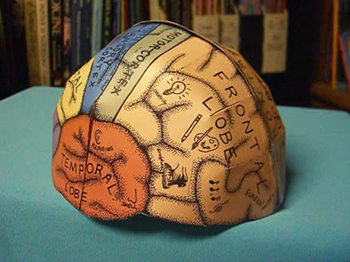
Notes:
After studying the brain and what each part does, students make a 3d version and label the different parts and their functions. Instructions for brain are hyperlinked.

Slide 6
Notes:
Discuss the parts and functions of the brain. Complete all 3 foldable activities in notebooks.

Slide 7
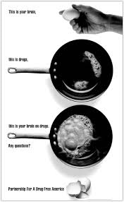
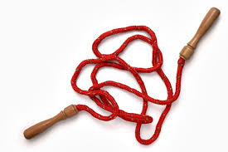
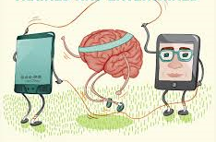
This is your brain…
This is learning…
This is your brain on learning…
Notes:
Explain the figurative language behind the “This is your brain on drugs” campaign. Refer to the poster and the hyperlinked video. Ask students to create a similar (positive) poster for “This is your brain on learning.”

Slide 8
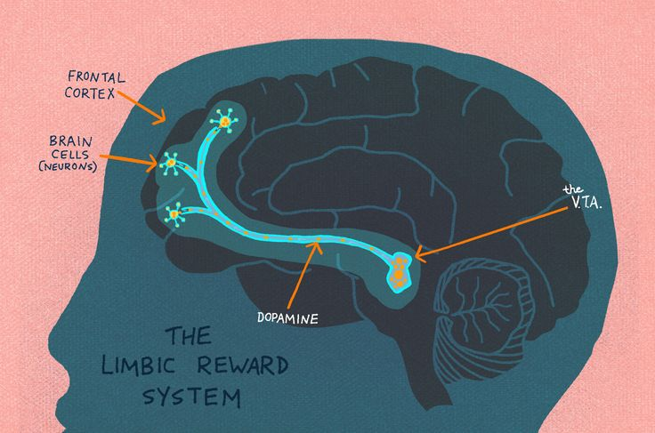
CURIOSITY
Notes:
Link to article: Curiosity: It Helps Us Learn, But Why? Print and distribute with highlighters. Read orally with students. Students should highlight important aspects in order to complete a Sentence, Phrase, Word.

Slide 9
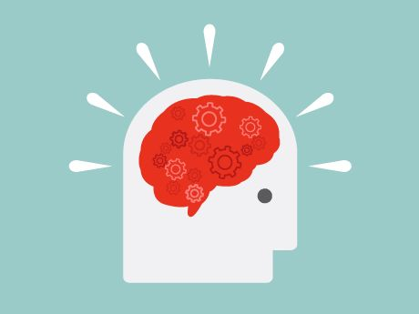
Five-Minute Film Festival: Learning and the Brain
Notes:
Brain Clips: -7 myths about the brain -How youth learn -How to teach students about the brain

