Slide 1

Seven Habits of Highly Effective Teens
Study Skills
Sean Covey

Slide 2
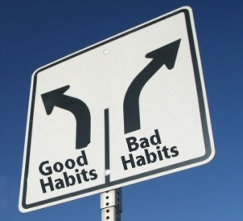
Habits
http://www.search.ask.com/videos?q=explaining+habits+to+teens&o=10146&tpr=2&ts=1394586322321
Begin with the End in Mind
Be Proactive
Synergize
Put First Things First
Sharpen the Saw
Think Win-Win
Notes:
Show slide show and then show YouTube video “seven habits of highly effective teens” football players
Then read pages 4-6 in book

Slide 3
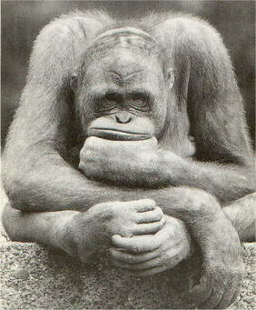
Think
Notes:
Chalk talk : Write the topic HABIT in your interactive notebooks… for three minutes I want you to think about what habits you have as a person (habits your don’t even think about any more, personal habits, social habits, things you do repeatably

Slide 4


Good Habits vs Bad Habits
Notes:
Read page 7 – 7 habits of highly defective teens in book- have the kids come up and list good vs bad habits they have or they have seen with other kids/people

Slide 5
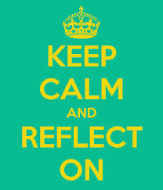
1. Two great habits I have are…
The results I get from having these habits are… (if you have a habit of smiling result=people smile back)
List a habit you have that is neutral (not good or bad-just a habit)
Notes:
Read Pages 8-9 What Exactly are Habits and 7 Habits can Help you
In their interactive textbooks write the answers to the following questions and answer on the left hand side

Slide 6

My 2 worst habits at this time are…
The reason I have these bad habits are…
The results I get from these bad habits are…
The one bad habit I would like to change is…
Notes:
In their interactive textbooks write the answers to the following questions and answer on the right hand side

Slide 7

See | Think | Wonder
Notes:
Explain - they will look at a picture on next slide in silence and think for 1-2 minutes.. In interactive notebooks write down this chart
When they get to the picture they will write what they SEE….. What do they THINK about the picture anything that comes to mind, what’s going on? What do you see? What makes them say that?…. What do you WONDER about the picture and relating it to the image, yourself, life…..

Slide 8
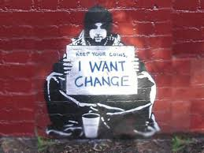

Notes:
Set a timer for 10 minutes and then discuss – This discussion should lead into the T-chart for changing bad habits and replacing them with good habits

Slide 9
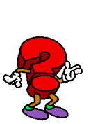
Bad habits I want to change
Good habits I want to replace them with
In School
With my Family
With my Friends
Notes:
Document in interactive textbooks… Make the T-chart and fill in each side… May have some discussion regarding friends or family members as examples. Stay away from getting too personal out loud but have them right about themselves in their books

Slide 10
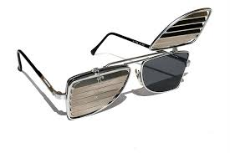
http://www.youtube.com/watch?v=3IyHJsCdo4w
Notes:
Read pages 11-16 before viewing video… Make sure they have an understanding of Paradigms… Get feedback and have them think about Ann’s paradigm and the family’s paradigm – What lens are they looking through????? Are they looking through blinders or a clear lens????

Slide 11

Notes:
Have the kids focus on 1-3 words… Relate them to negative paradigms… How do these negative paradigms impact their lives.. How does it change their clear lens to blinders??? Reflect and talk as a group

Slide 12
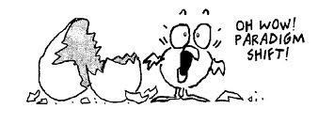
Paradigms of Self
Positive Paradigms…
Negative Paradigms…
IF someone were going to name something after me, it would be.
Notes:
On the left hand side of their notebook page: Have students list some positive paradigms about themselves in their interactive notebook. Then have students list some negative paradigms about themselves in their interactive notebook. ON the right hand side of the notebook have them draw a picture to go with the prompt “If someone were going to name something after me, it would be.”

Slide 13
“If who I am is what
I have and what I
Have is lost, then who
Am i??????
Notes:
Read page 18-23 Paradigms of Life friend centered, stuff centered, boyfriend girlfriend centered, school centered, parent centered – Talk with a friend where do you think you fit… Do you center too much of your life around one or the other? Share out your thoughts

Slide 14
Being a mom
Friendships
Being a wife
Perseverance
Work
Staying Healthy
Professional
Development
Notes:
Read pages 24-27 – Principle Centered – The Real Thing – Talk about a life of principles and then talk about a life based on the opposite; laziness, dishonesty, ingratitude, hate, selfishness…. Have students think of a principle they live by and that goes in the middle. Then show how that principle influences their life.

Slide 15
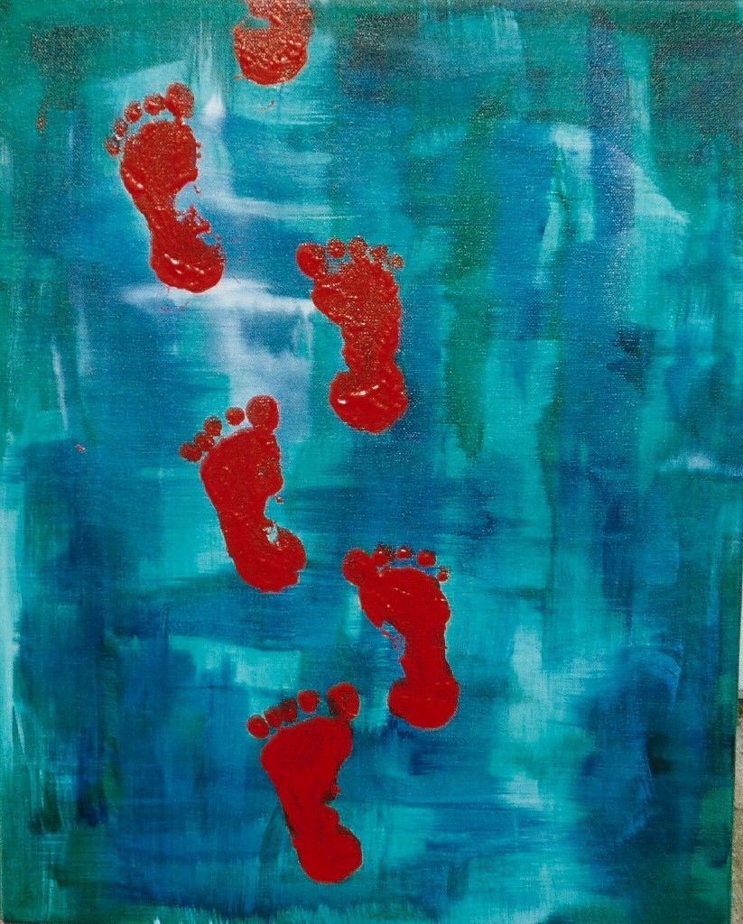
http://www.youtube.com/watch?v=p3JPa2mvSQ4
Notes:
Watch video clip “What about Bob?” regarding baby steps…. Read page 28 – Baby Steps - Have students choose for themselves what baby step are they going to take / small steps that they can apply that center around what we have talked about so far (a principle, new habit, a shift in their paradigm….)

Slide 16
http://www.youtube.com/watch?v=PivWY9wn5ps
Keep promises to yourself
Do small acts of kindness
Be gentle with yourself
PBA Deposits
PBA Deposits
Renew yourself
Tap into your talents
Be honest
Notes:
Read page 31-34 – Personal Bank Account Watch video then talk about depositing into your personal bank account – put chart paper around the room or write on desks with dry erase marker. (six desks or six pieces of chart paper) On each write the PBA deposits from page 35-41. Set a timer for intervals of a minute and have students go from desk to desk after a minute to comment, write, list… regarding each deposit

Slide 17
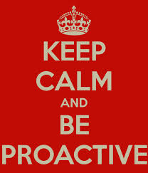

http://www.youtube.com/watch?v=o3Gu0dPc8TA
Habit 1
Notes:
Show video then read pages 48-49 – Don’t read the scenes yet. In the interactive text books draw a picture on the left that would symbolize a person that is proactive then draw a picture on the right that would symbolize someone who is reactive. Then read the scene one and scene too… For each scene have kids / group come up with proactive language and reactive language for each of he two scenes and collect on slide

Slide 18
I
Autobiography in
FIVE SHORT CHAPTERS
From There’s a Hole In My Sidewalk
By: Portia nelson
http://www.youtube.com/watch?v=KRNICA2VvX4

Slide 19



____________________________________________________
____________________________________________________
____________________________________________________
____________________________________________________
____________________________________________________
____________________________________________________
____________________________________________________
____________________________________________________
____________________________________________________
____________________________________________________
____________________________________________________
____________________________________________________
Habit 2
Notes:
Read page 74-76 and have a discussion – Then read page 81-83 and discuss how your personal mission statement is something that puts you in control of your life everyday. Then do the Great Discovery Game… Print out the slides 19 and 21 for the students to answer and put in their interactive notebooks – read the game from pages 86-89

Slide 20
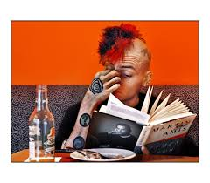
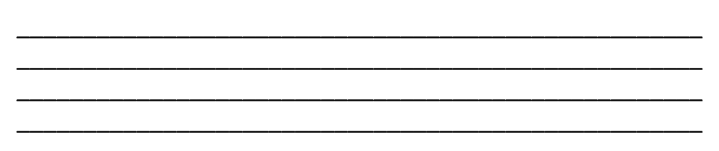



Slide 21

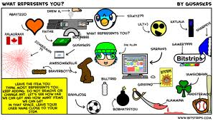


Numbers Words Athletics Artistic
Making things happen Working well with people Listening
Speaking Humorous Sharing Music
Singing Memorizing Mechanical Decisions
Building Trivia Writing Creating

Slide 22
http://www.youtube.com/watch?v=bM8KJpBme7Y
To Realize the value of One Year,
Ask a student who failed his/her _______________.
To realize the value of One Month,
Ask a ____________________________________.
To realize the value of One Week,
Ask a(n) __________________________________.
To realize the value of One Day,
Ask a ____________who has to _______________.
To realize the value of One Hour,
Ask a person who survived __________________,
To realize the value of one Millisecond.
Ask the person who won a silver medal in the Olympics.
Habit 3
Notes:
Read page 106-107 and page 116 Does it Really Work? Watch video and discuss…. Then read page 122-123 – Be Strong in Hard Moments Activity: Read page 126-127 Final Word Then talk about the slide and have students, in their interactive notebooks write the poem on the slide and fill in the blanks with their own thoughts.

Slide 23
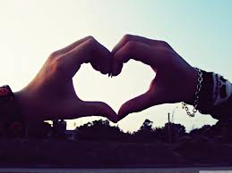
RBA
http://www.youtube.com/watch?v=-OBgdoAmuwI&list=PLR5MW-YMRMKMxzWxLWC8ww0EUNDkdcl_z
Keeping Promises
Do Small Acts of Kindness
Be Loyal
Listen
Say You are Sorry
Set Clear Expectations
Notes:
Relationship Bank Account Read pages 130-133 – Discuss what to deposit into the relationship bank account – then read scenarios and discuss on pages 137, 140,141(2 scenarios),142-143 clear expectations – Play video then hand out random names of kids in class to other kids. Have them write one kind statement to that person

Slide 24
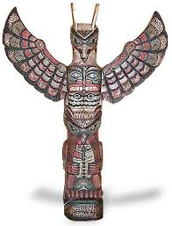
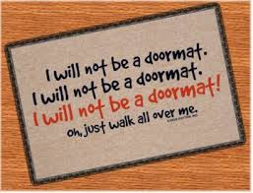
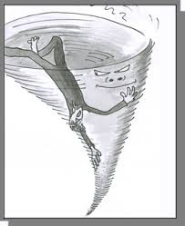
Habit 4
Notes:
Read 146-152 – skip around read scenarios get the main points of Totem, Doormat, and Downward Spiral – just have a discussion – book talk – relaxed – get some individual scenarios from kids who have been in each situation / After the discussion make a Win-Win poster for the whole class to contribute to – Listen to some upbeat music while decorating on poster… writing…

Slide 25
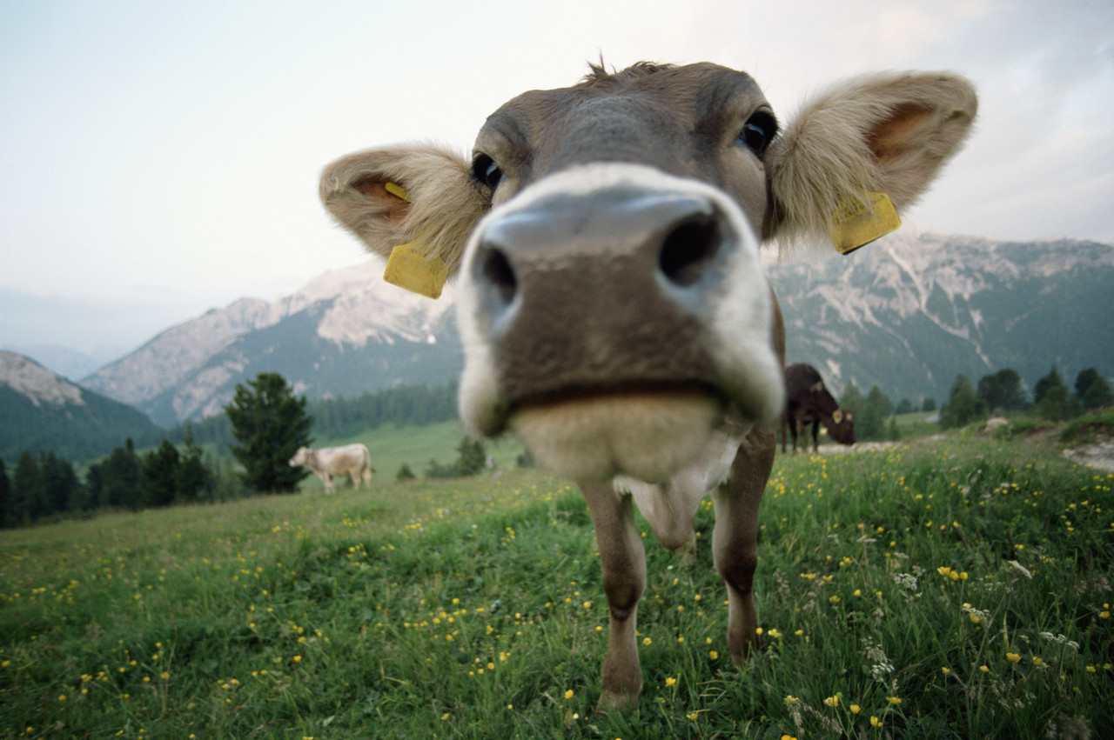
Are you LISTENING???
Habit 5
Notes:
Read page 164 and the top of 165 – have a discussion about how you can tell a person is listening (body language, words, eyes, comments…) how can you tell if a person isn’t listening (body language, words, eyes, comments…) Read page 166-167 bottom of 166 over to 167 after discussion have kids pair up and assign groups to be good listening group or poor listening group – Have them come up with a short skit to perform in front of the class and collect on large paper things they notice the groups doing that define good listening and poor listening…

Slide 26

Synergy
Habit 6
Notes:
Read page 182-183

Slide 27
We all have different styles, traits, and characteristics. The following exercise is a fun look at some of your general characteristics and personality traits!
Read across each row and place a 4, 3, 2, or 1 in the shaded box to rank how you would best describe yourself. A 4 means that this word best describes you. A 1 means that this word least describes you. Do this for each row.
Notes:
Make a copy of the fruit personality test and have kids take it and see their different styles, traits and characteristics. Have them turn to a friend and see if the friend agrees and share out. Put in interactive notebook

Slide 28
http://www.youtube.com/watch?v=5rOg4WfNDfM
Notes:
Watch Video

Slide 29

Body – Mind – Heart - Soul
Quit habits that are bad for
your body, mind, heart, soul
Balance and moderation
In all things!
Good sleeping habits, physical relaxation, good nutrition, proper exercise
STOP AND THINK
Ask questions
Name the trouble
State the consequence
Suggest an alternative
Take off
Habit 7
Notes:
Read page 206 - Talk about ways to nourish your body, mind, heart and soul – Read page 216 Caring for Your Brain and discuss; Read page 218-219 Find Your Niche and discuss

Slide 30

http://www.youtube.com/watch?v=1G7RZfkGjOY

